Slide 1




RR
GOLD
BUSINESS PROPASAL
www.rrgold.biz

Slide 2



RR
GOLD
ABOUT US
Welcome to RRGold, a trusted name in the gold jewellery industry with decades of experience in crafting exquisite gold pieces. As a leading manufacturer and wholesaler, we take pride in our commitment to quality, innovation, and customer satisfaction.
With a legacy of trust and excellence, RRGold has been a pioneer in the industry, introducing India's first company to revolutionize gold booking schemes into digital platforms. Our expertise in designing and manufacturing a wide range of gold jewellery has earned us a reputation for excellence, making us a preferred partner for wholesalers, retailers, and customers across the country.
www.rrgold.biz

Slide 3


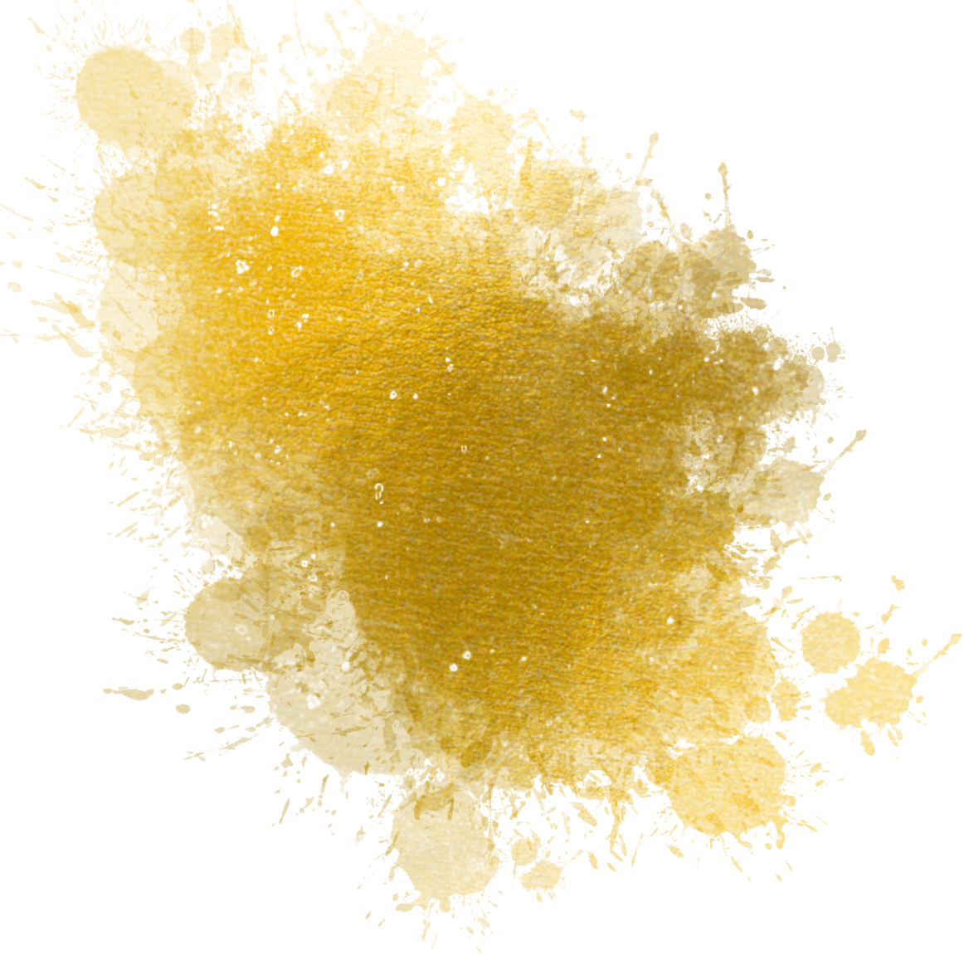
RR
GOLD
TRADITION MEETS INNOVATION
At RRGold, we blend traditional craftsmanship with modern technology to create stunning gold jewellery pieces that reflect the essence of Indian heritage. Our team of skilled artisans and designers work tirelessly to bring you the finest collection of gold jewellery, carefully crafted to meet the highest standards of quality and purity.
As a socially responsible organization, RRGold is committed to transparency, integrity, and customer-centricity. We strive to build long-term relationships with our stakeholders, driven by our core values of trust, innovation, and excellence.
www.rrgold.biz

Slide 4
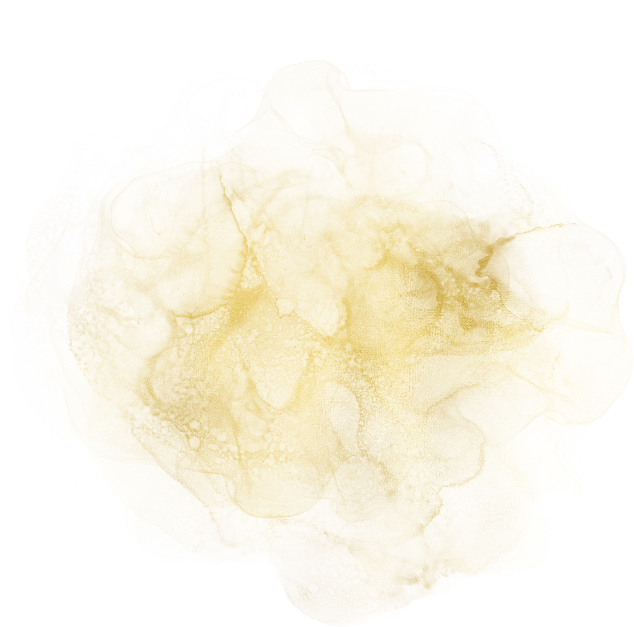



RR
GOLD
OUR VISION
To revolutionize the gold jewellery industry with digital innovation, setting new standards for quality, purity, and customer satisfaction.
OUR MISSION
To be the leading gold jewellery manufacturer and wholesaler, renowned for our exceptional quality, innovative designs, and customer-centric approach.
www.rrgold.biz

Slide 5

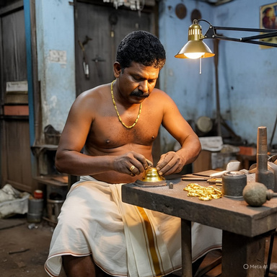
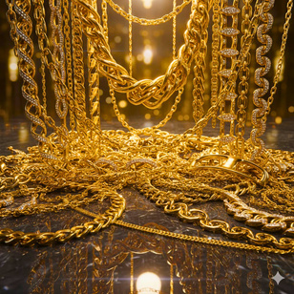
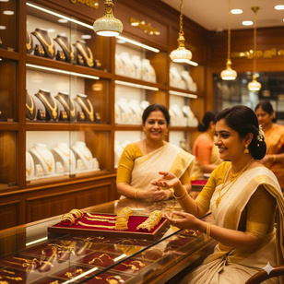
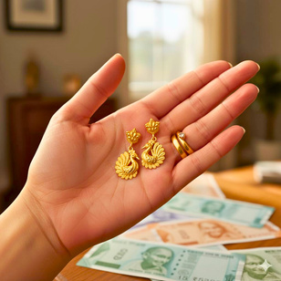
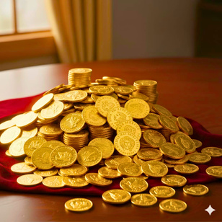
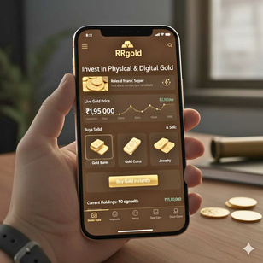
OUR ACTIVITIES
RR
GOLD
GOLD SCHEMES
MANUFACTURING
WHOLESALING
RETAILING
OLD GOLD DEALINGS
GOLD COINS
ONLINE SHOPING
www.rrgold.biz

Slide 6

RR
GOLD
GOLD SCHEMES OVERVIEW
MINT
MASTER
MAXX
Beginner’s Scheme
Intermediate Scheme
Advanced Scheme
www.rrgold.biz

Slide 7

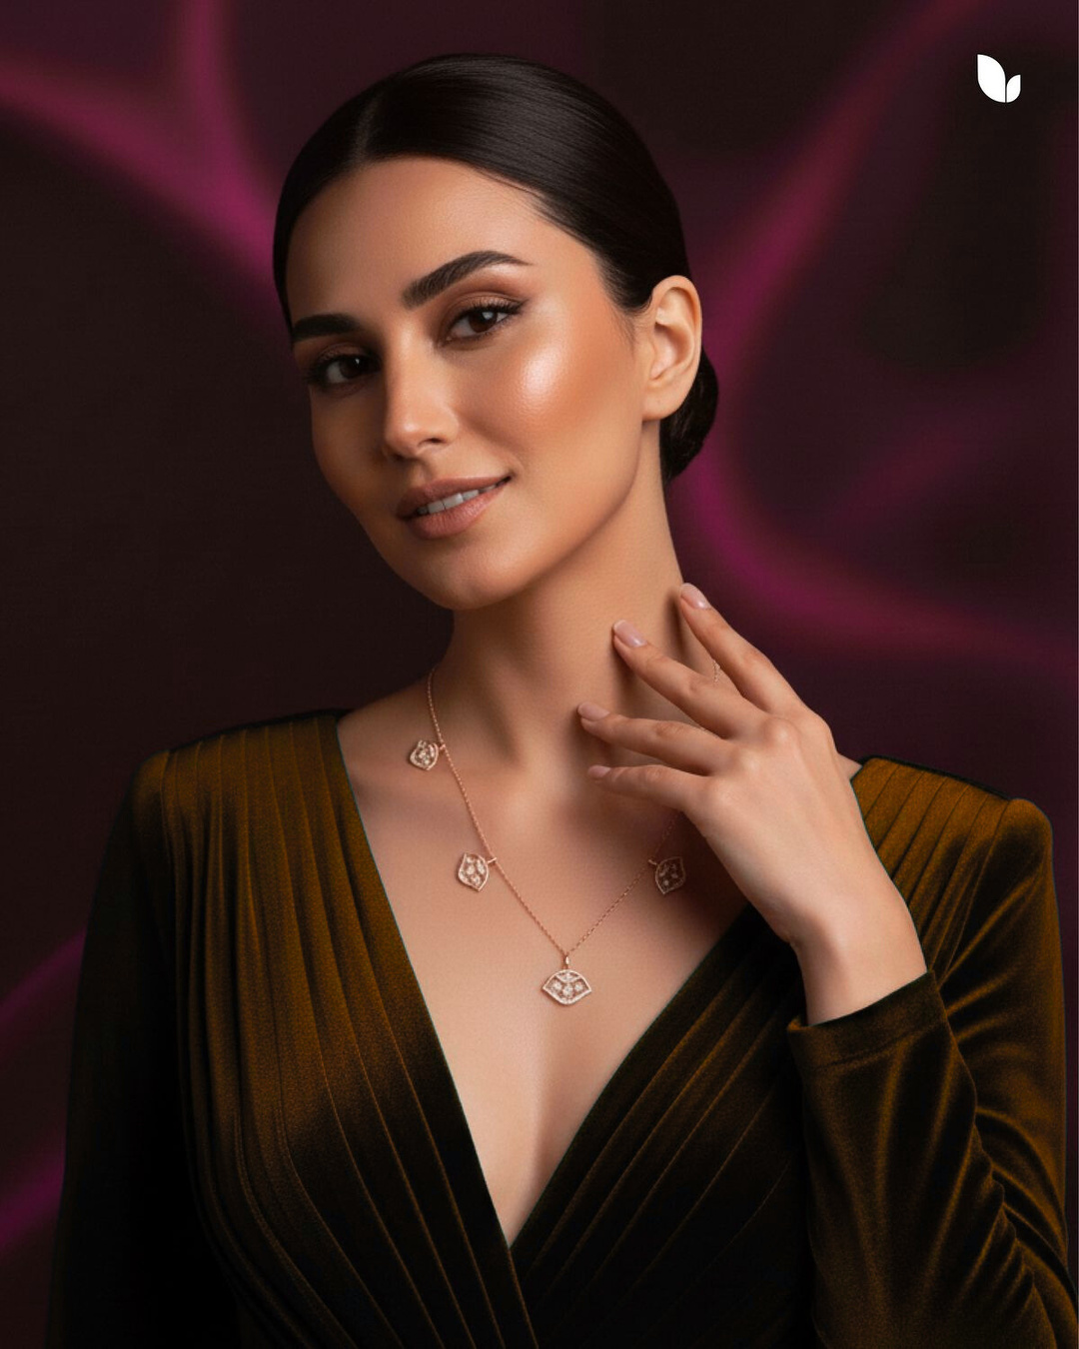


RR
GOLD
6000
12000
24000
48000
MINT
96000
The Mint is designed to provide significant daily earnings based on purchase amount and offers a "clear path to substantial value to gold.
  The Scheme offers Value Appreciation 0.7% (VA) greater than 152 time
  Tenure - 364 days (from bill of purchase)
www.rrgold.biz

Slide 8
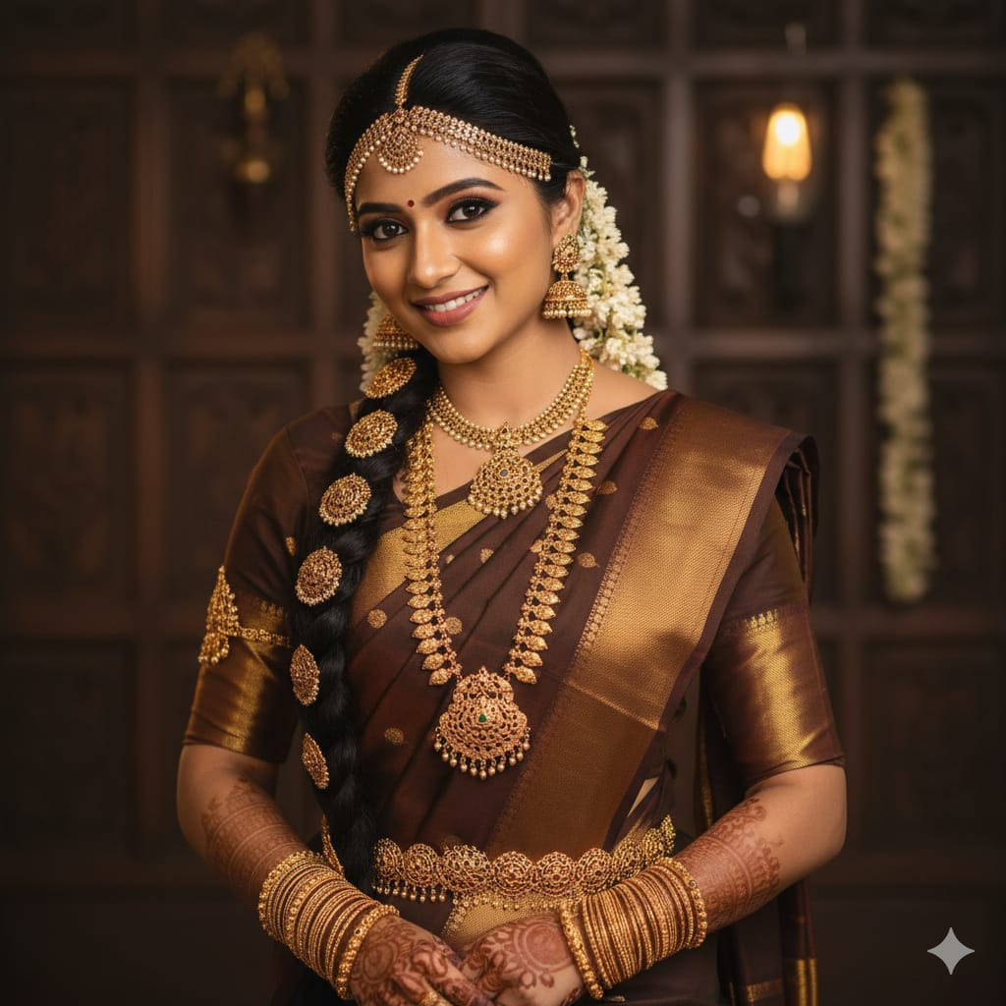
RR
GOLD
₹ 10000 to ₹ 100000
₹6000 Mint
₹ 100000 to ₹ 250000
₹12000 Mint
₹ 250000 to ₹ 500000
₹24000 Mint
₹ 50000 t0o ₹ 750000
₹48000 Mint
MASTER
₹ 750000 to ₹ 1000000
₹96000 Mint
The Master Offers tiered purchase option building on the foundation of the Mint Purchase
  The Scheme offers Value Appreciation 1% (VA) greater than 152 time
  Tenure - 364 days (from bill of purchase)
www.rrgold.biz

Slide 9
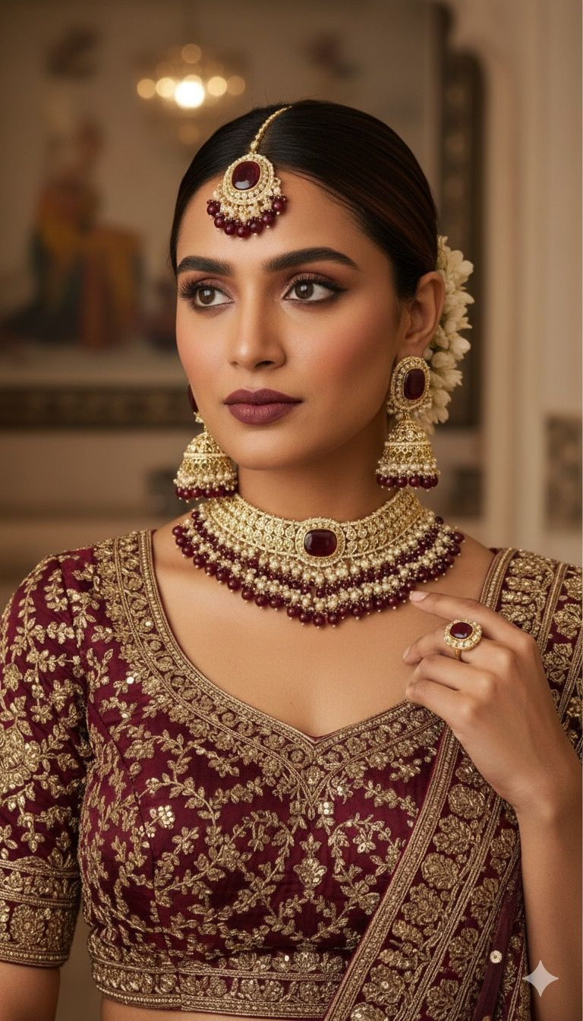
RR
GOLD
₹ 10000 to ₹ 100000
₹6000 Mint
₹ 100000 to ₹ 250000
₹12000 Mint
₹ 250000 to ₹ 500000
₹24000 Mint
₹ 500000 to ₹ 750000
₹48000 Mint
MAXX
₹ 750000 to ₹ 1000000
₹96000 Mint
Also The Maxx Offers tiered purchase option building on the foundation of the Mint Purchase
  The Scheme offers 16% per month, including principal and value appreciation (VA).
  Tenure - 10 Months (from bill of purchase)
www.rrgold.biz

Slide 10

RR
GOLD
CAPPING
₹6000 Mint
MAX CAPPING ₹60000
₹12000 Mint
MAX CAPPING ₹120000
₹24000 Mint
MAX CAPPING ₹240000
₹48000 Mint
MAX CAPPING ₹480000
₹96000 Mint
MAX CAPPING ₹960000
  The Capping of Promotional Bonuses an individual can earn will be based on the Mint they purchase.
  The promotional earnings limit can be increased by increasing the Mint purchase.
www.rrgold.biz

Slide 11


RR
GOLD
PROMOTERS BONUSES
Existing and active customers who introduce new customers, as well as their affiliated group, are entitled to receive "Promoter's Bonuses.
FOR MINT PROMOTIONS
  ​Sales Bonus: 10% of each Mint Purchasing Amount of a Privilage Customer.
  ​Team Bonus: Bonus based on accumulated Golden Points (GP) from individual or group affiliate sales.
• ​The Daily Limit of Team Sales bonus of an individual will be based on the Mint purchase.
• ​The Team Sales bonus limit can be increased by increasing the Mint purchase.
₹6000 - ₹6000 Limit | ₹12000 - ₹12000 Limit | ₹24000 - ₹24000 Limit | ₹48000 - ₹48000 Limit | ₹96000-₹96000 Limit
www.rrgold.biz

Slide 12

RR
GOLD
FOR MASTER & MAXX PROMOTIONS
Grade Bonus: Bonus according to Master & Maxx purchases from group affiliate sales from each grades
1st Grade
10%
2nd Grade
3%
3rd Grade
2%
4th to 8 th Grades
1%
Extra 1% Bonus from 9th to 13th Grades , upon providing a minimum of 2 new customer referrals in Mint.
www.rrgold.biz

Slide 13
RR
GOLD
REPUTATIONS ,SALARY & REWARDS
Reputations
Team Sales Bonus
Salary & Rewards
Gold Partner
₹30000
RR Gold Bag
Gold Advisor
₹60000
Smart Phone
Group Leader
₹120000
₹20000 × 3 Months Salary
Executive
₹240000
₹30000 × 3 Months Salary
Manager
₹480000
₹50000 × 3 Months Salary
www.rrgold.biz

Slide 14
RR
GOLD
Reputations
Team Sales Bonus
Salary & Rewards
Ambassador
₹960000
Car Fund – ₹200000
Director
₹1920000
House Fund – ₹500000
Ruby Director
₹3840000
₹200000 × 3 Months Salary
Emerald Director
₹7680000
₹500000 × 6 Months Salary
Founder’s Circle
₹15360000
1% Turnover × 3 Months
www.rrgold.bizz

Slide 15

RR
GOLD
TRADITION
MEETS
INNOVATION
www.rrgold.biz

Slide 16


RR
GOLD
Rajan Ravindran Gold Manufactures and Wholesalers LLP
32/1937 D5,BL Plaza, Near Anchumana Temple,Edappally, Ernakulam - Kerala - 682024
rrgoldbiz@gmail.com
- rrgold.biz-

